Slide 1
Sorting Part 3
CS221 – 3/6/09

Slide 2
Sort Matrix
Name | Worst Time Complexity | Average Time Complexity | Best Time Complexity | Worst Space (Auxiliary)
Selection Sort | O(n^2) | O(n^2) | O(n^2) | O(1)
Bubble Sort | O(n^2) | O(n^2) | O(n) | O(1)
Insertion Sort | O(n^2) | O(n^2) | O(n) | O(1)
Shell Sort
Merge Sort
Heap Sort
Quicksort

Slide 3
Shell Sort
Shell sort is an improved version of Insertion Sort
Instead of O(n^2) it has O(n^3/2) or better
Shell sort performs iterative sorts on sub-array ‘slices’ to reduce the number of comparisons

Slide 4
Shell Sort
Shell sort compares across gaps rather than side-by-side
Allows the elements to take bigger ‘steps’ toward the correct location
Over successive iterations the gap is reduced, until the list is sorted

Slide 5
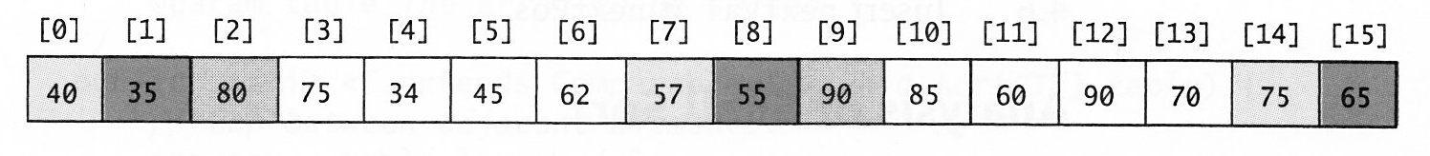
Iteration 1, Gap of 7
Sort 40, 75, 57
Sort 35, 55, 65
Sort 80, 90

Slide 6
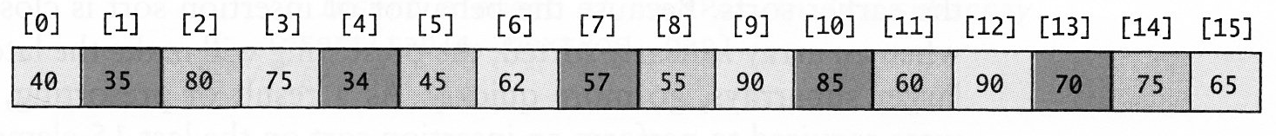
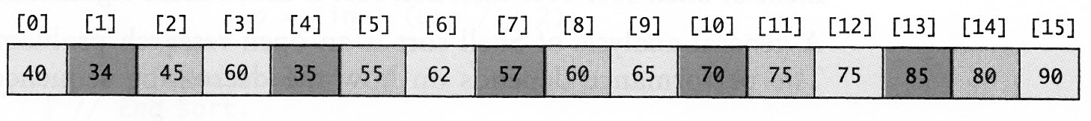
Iteration 2, Gap 3
Sort 40, 75, 62, 90, 90, 65
Sort 35, 34, 57, 85, 70
Sort 80, 45, 55, 60, 75

Slide 7
Iteration 3, Gap 1
Complete a full insertion sort on the nearly sorted array
Requires fewer comparisons than if we’d started with the random data

Slide 8
Mind the Gap
Using 32, 16, 8, 4, 2, 1 results in O(n^2)
Using 31, 15, 7, 3, 1 results in O(n^3/2)
Research is still being conducted on ideal gap sequences

Slide 9
Shell Sort Visual
http://www.sorting-algorithms.com/shell-sort

Slide 10
Pseudo Code
Gap = round (n/2)
While gap > 0
for index = gap ... n
temp = array[index]
subIndex = index
while subIndex >= gap and array[subIndex – gap] > temp
array[subIndex] = array[subIndex – gap]
subIndex = subIndex – gap
array[subIndex] = temp
gap = round(gap/2.2)

Slide 11
Pseudo Code Improved
Gap = round (n/2)
While gap > 0
for index = gap ... n
insert(array, gap, index)
gap = round(gap/2.2)

Slide 12
Pseudo Code Improved
insert(array, gap, index)
temp = array[index]
subIndex = index
while subIndex >= gap and array[subIndex – gap] > temp
array[subIndex] = array[subIndex – gap]
subIndex = subIndex – gap
array[subIndex] = temp

Slide 13
Shell Sort Complexity
What is the space complexity?
Is the data exchanged in-place?
Does the algorithm require auxiliary storage?

Slide 14
Sort Matrix
Name | Worst Time Complexity | Average Time Complexity | Best Time Complexity | Worst Space (Auxiliary)
Selection Sort | O(n^2) | O(n^2) | O(n^2) | O(1)
Bubble Sort | O(n^2) | O(n^2) | O(n) | O(1)
Insertion Sort | O(n^2) | O(n^2) | O(n) | O(1)
Shell Sort | O(n^2) | O(n^5/4) | O(n^7/6) | O(1)
Merge Sort
Heap Sort
Quicksort

Slide 15
Merge Sort
Our first recursive sort algorithm
Break the list in half
Sort each half
Merge the results
How do you sort each half? (see above)

Slide 16
Merge Sort
By partitioning the sort space into smaller and smaller pieces, time to sort is reduced
Based on two assumptions:
A set of small lists are easier to sort than a single large list
Merging two sorted lists is easier than sorting an unsorted list of equal size
Merge sort is an online algorithm – it can accept streaming data.

Slide 17
Merge Sort
Two major steps:
Partition as you build up the stack
Merge as you unwind the stack
Merge is where most of the work is done
Work through each list in order
Successively copy the smallest item into the new list

Slide 18
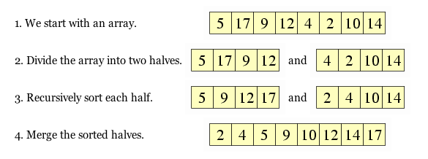
Merge Sort Example

Slide 19
Merge Sort Visual
http://coderaptors.com/?MergeSort

Slide 20
mergeSort algorithm
If array <= 1 return the array
Copy half the array into left and half into right
Recursively sort left and right
Merge left and right into a single result

Slide 21
Pseudo Code
mergeSort
if n <=1
return array
middle = n/2
for index = 0 ... middle - 1
leftArray[index] = array[index]
for index = middle … n
rightArray[index-middle] = array[index]
left = mergeSort(left)
right = mergeSort(right)
return merge(left, right)

Slide 22
merge Algorithm
Compare the first item in right to the first item in left
Copy the smallest into output
Increment the list you copied from
Repeat until you’ve reached the end of right or left
Copy the remaining items from left or right into output if there are any

Slide 23
Pseudo Code
merge(left, right)
while leftIndex < left.length and rightIndex < right.length
if (left[leftIndex] <= right[rightIndex])
result[resultIndex] = left[leftIndex]
resultIndex++
leftIndex++
else
result[resultIndex] = right[rightIndex]
resultIndex++
rightIndex++
while leftIndex < left.length
result[resultIndex] = left[leftIndex]
resultIndex++
leftIndex++
While rightIndex < right.length
result[resultIndex] = right[rightIndex]
resultIndex++
rightIndex++

Slide 24
Merge Sort Complexity
What is the time complexity?
What is complexity if the merge?
What is complexity of the recursive mergeSort?
What is the space complexity?
Is the data exchanged in-place?
Does the algorithm require auxiliary storage?

Slide 25
Sort Matrix
Name | Worst Time Complexity | Average Time Complexity | Best Time Complexity | Worst Space (Auxiliary)
Selection Sort | O(n^2) | O(n^2) | O(n^2) | O(1)
Bubble Sort | O(n^2) | O(n^2) | O(n) | O(1)
Insertion Sort | O(n^2) | O(n^2) | O(n) | O(1)
Shell Sort | O(n^2) | O(n^5/4) | O(n^7/6) | O(1)
Merge Sort | O(n log n) | O(n log n) | O(n log n) | O(n)
Heap Sort
Quicksort

Slide 26
